Slide 1


IoTNegViz: An Interactive Tool for Visualizing Negative Aspects of IoT
Presenter
Dr. Tommy Dang
Assistant Professor, Texas Tech University
PhD Students
Huyen N. Nguyen
Vinh T. Nguyen
Ngan V.T. Nguyen
Vung Pham

Slide 2
Outline
Introduction
Related Work
Visualization Architecture
Case Study
Conclusion
2

Slide 3






Introduction
Things
Local Network
The Internet
Back-end Services
Servers
Gateways
User access
Billions data nodes
Potential subsequent risks can become severe due to the pervasive influence
Sensors Processes Communication
3
Notes:
The giant networks: billions data nodes containing data > pervasive influence > subsequent risks become severe

Slide 4
Project Overview
Gaining insights into negative aspects of IoT is crucial for raising awareness of the issues.
This project proposes visual approaches for exploring the downsides of IoT.
The visualization is expanded on the following dimensions:
The relationship between the aspects
Temporal domain: The evolution of topics over time
4

Slide 5
Project Overview
We therefore focus the following design goals:
Temporal overview across negative aspects distribution
Details-On-Demands and Filtering: Provide specific information of the IoT downsides
Relationship between the negative aspects
5

Slide 6
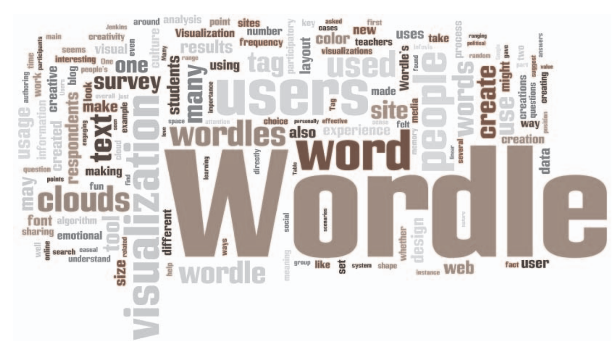
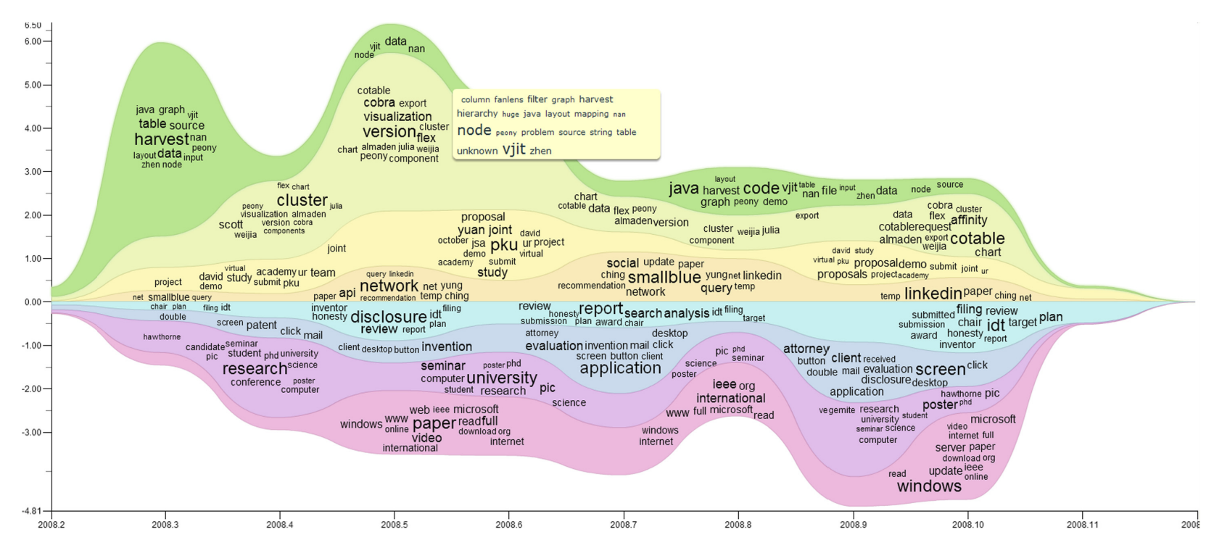
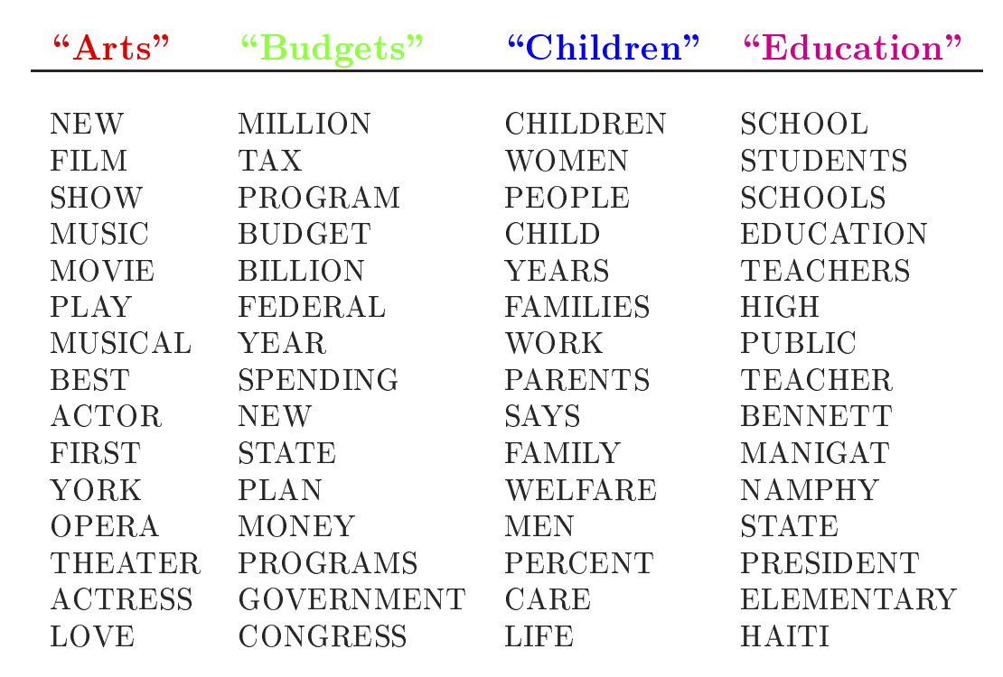
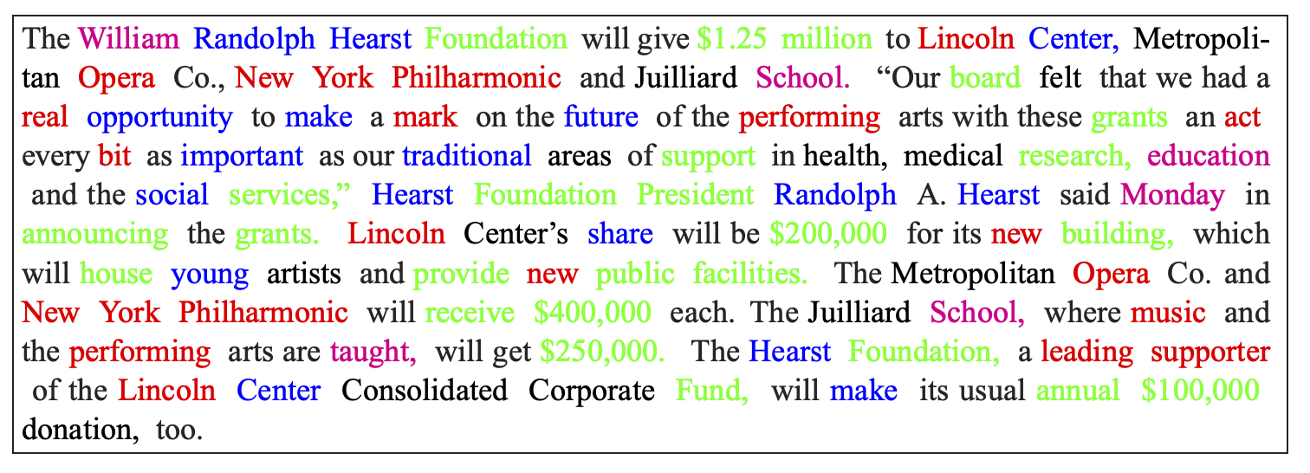
Related work
Text visualization
Wordle
ParallelTopics
TIARA
Topic modeling - LDA
6

Slide 7
Visualization Architecture
The dataset is retrieved from Twitter
Terms and topics are extracted by Natural Language Processing library spaCY
Two categories: Security risks and Physical accidents
https://twitter.com
https://spacy.io
7
Notes:
The raw data set contains 2597 tweets.

Slide 8
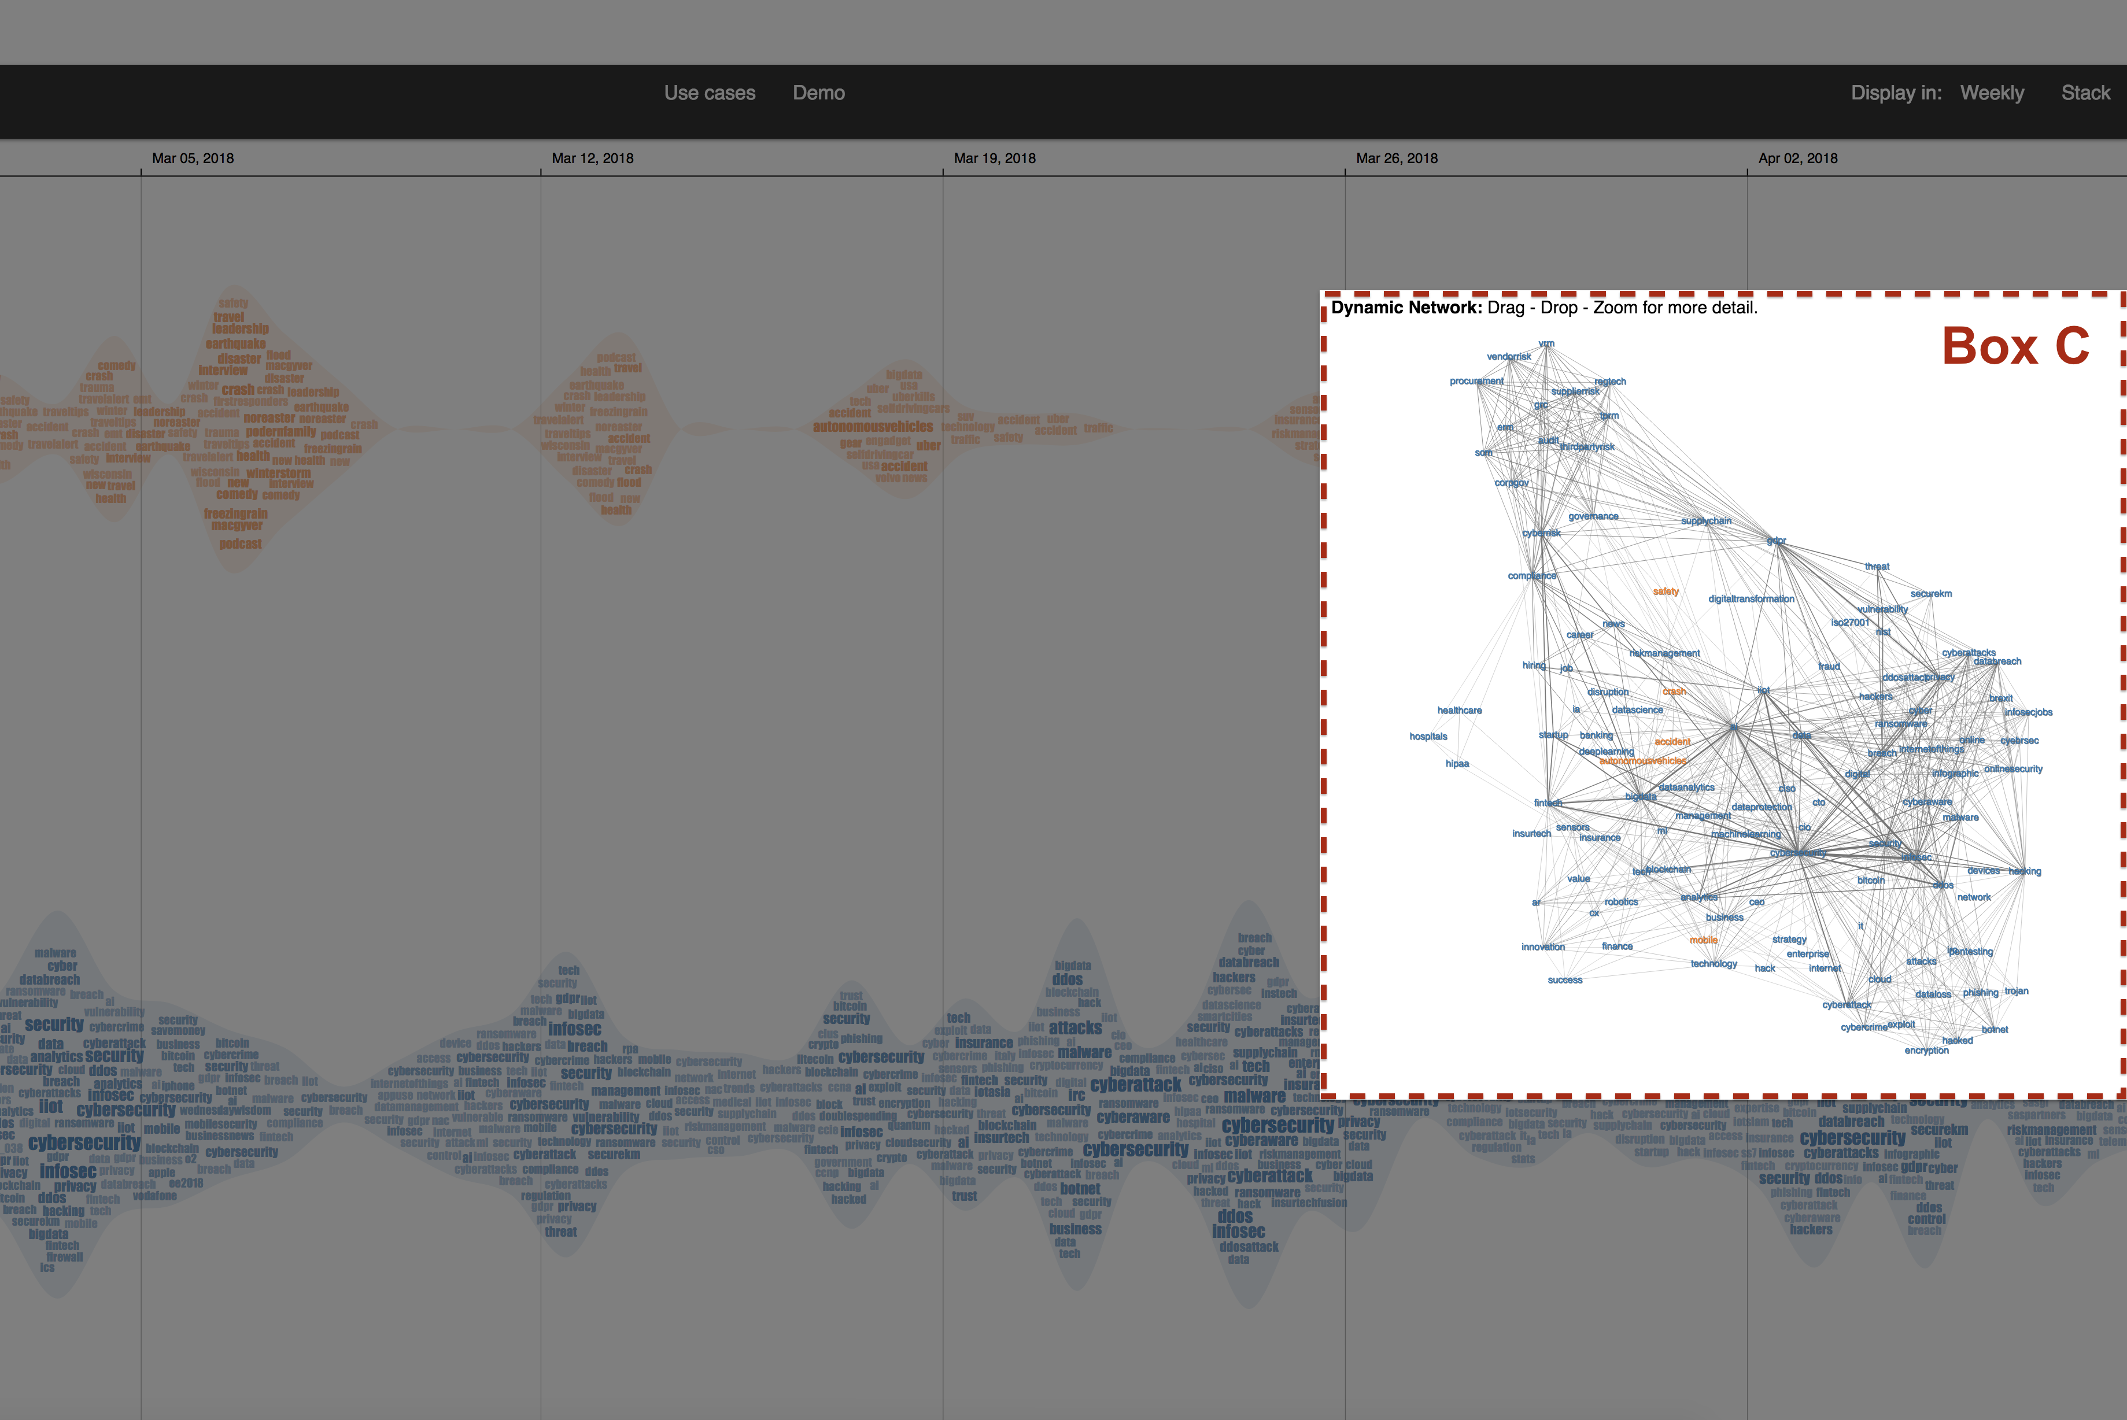
Visualization Architecture
Three main components of IoTNegViz:
A – Utility Component, B – Topic evolution and C – Dynamic network
8
Notes:
Box A - Utility component: ◦ Search toolbox offers autocomplete search suggestions listed below ◦ Use cases page shows the findings of the visualization and details for visual components. Demo page illustrates a demonstration with interactive tool of IoTNegViz. ◦ Display mode is default to present data by day. The Weekly and Stack options can be both choosen at the same time. The Weekly option is for displaying by week instead of day as default, and the Stack option is for stacking layers on top of each other. Box B - An area among the topic stream: Along with the timeline in the upper part of the screen, there are two streams in this visualization: The orange layer is for accidents that refer to the negative aspects, and the blue one is for the potential risks may occur. The shape of the stream directly associates with the stream’s thickness, which indicates the total frequency of the inside terms. The significance of each word is constructed based on its frequency, then emphasized in the visualization by its size and color opacity. Button C and Box C - The Dynamic Network: When users click on the button, a dynamic graph slides out. This is a force directed graph showing the connection and relationship between the negative aspects. A term is considered significant if it has multiple connections with other items

Slide 9
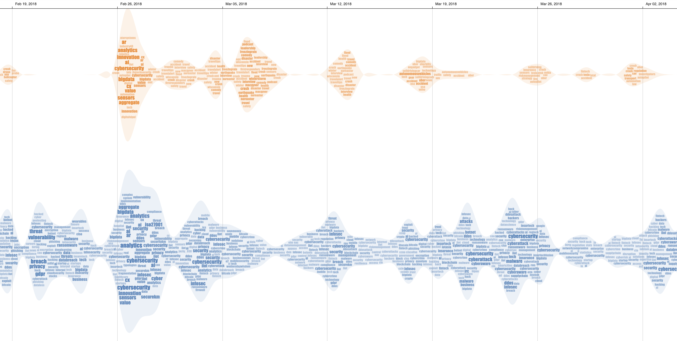
IoTNegViz – Topic Evolution
Physical accidents
Security risks
High frequency terms
9

Slide 10
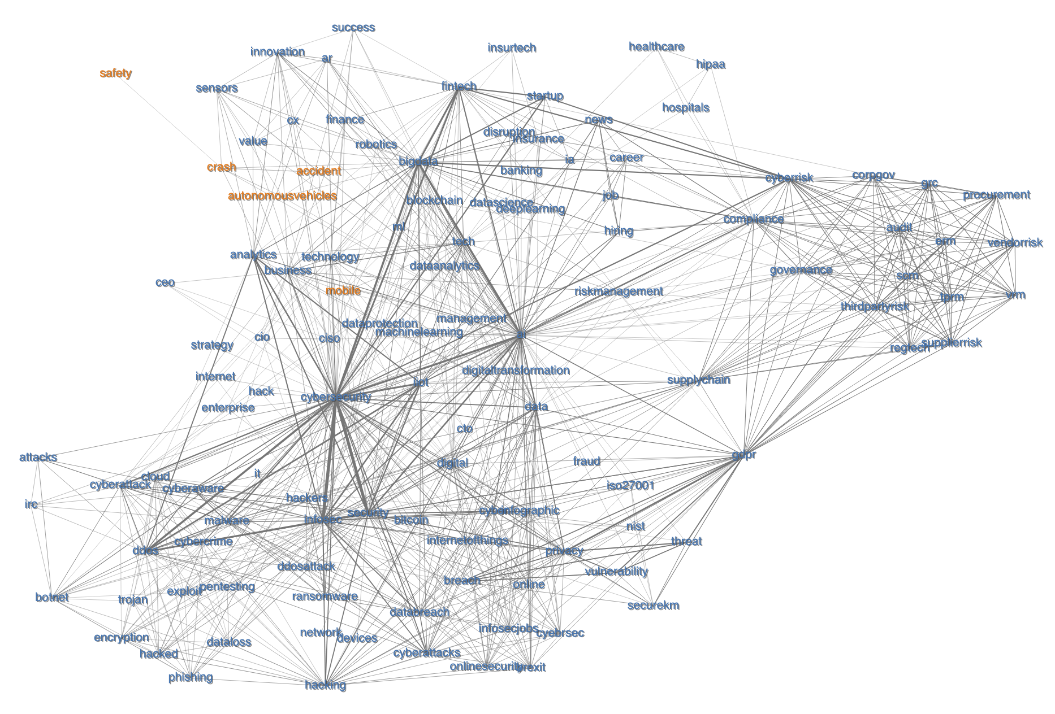
IoTnegViz – Dynamic Network
The thicker the connections, the stronger the relationships
Important term
10

Slide 11
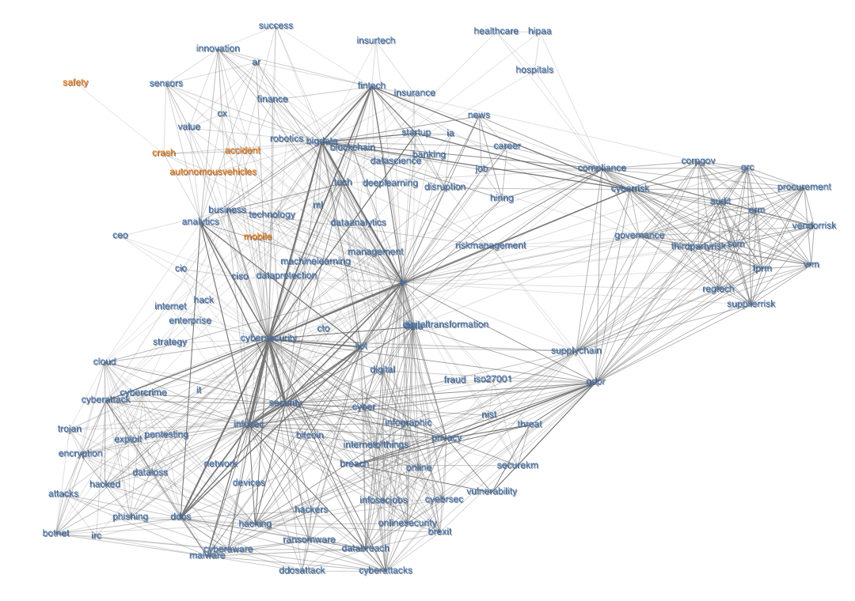
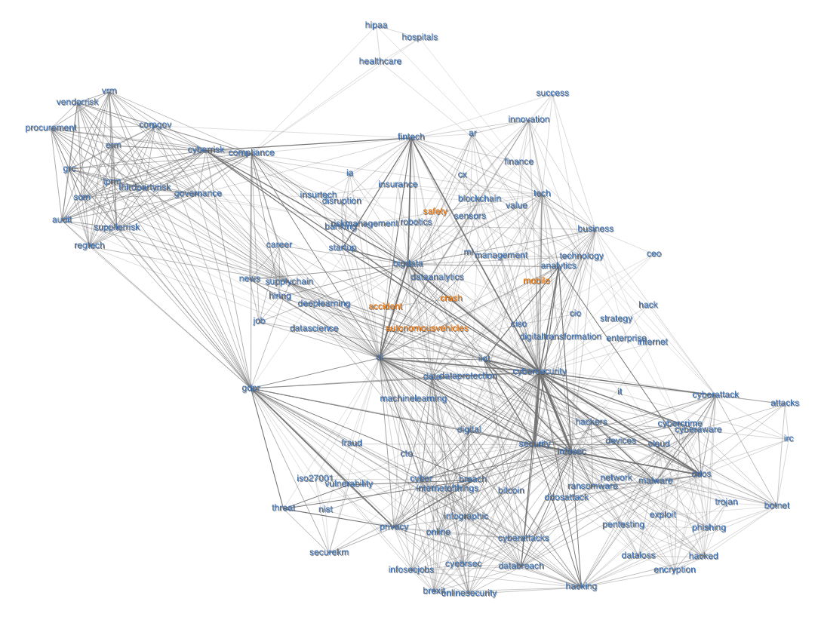
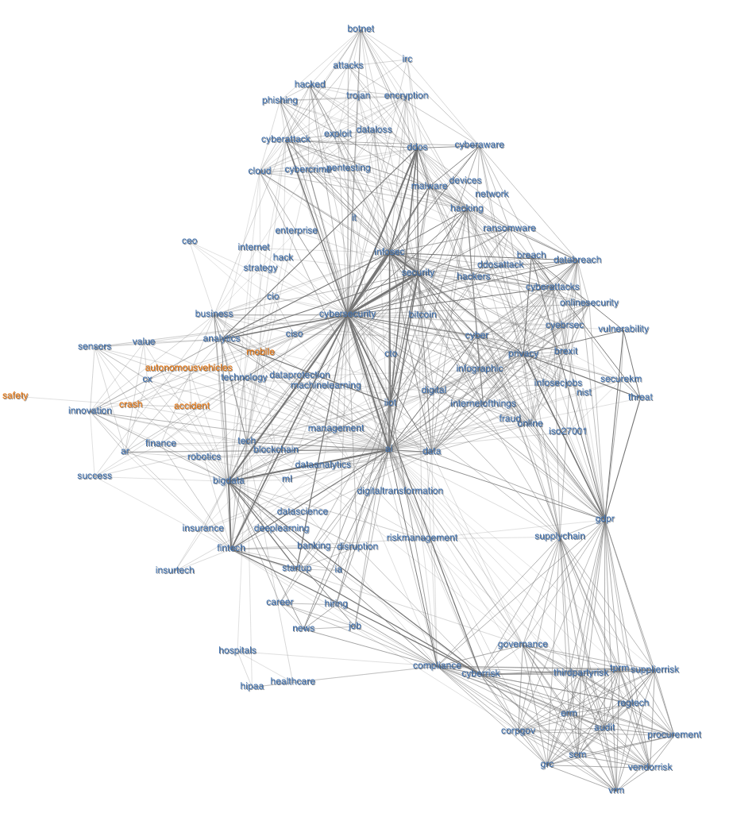
User Interactions
Mouse events
Mouse over
Mouse click
B. Filtering key words with autocompletion
C. Drag-and-Drop for exploring relations
11

Slide 12
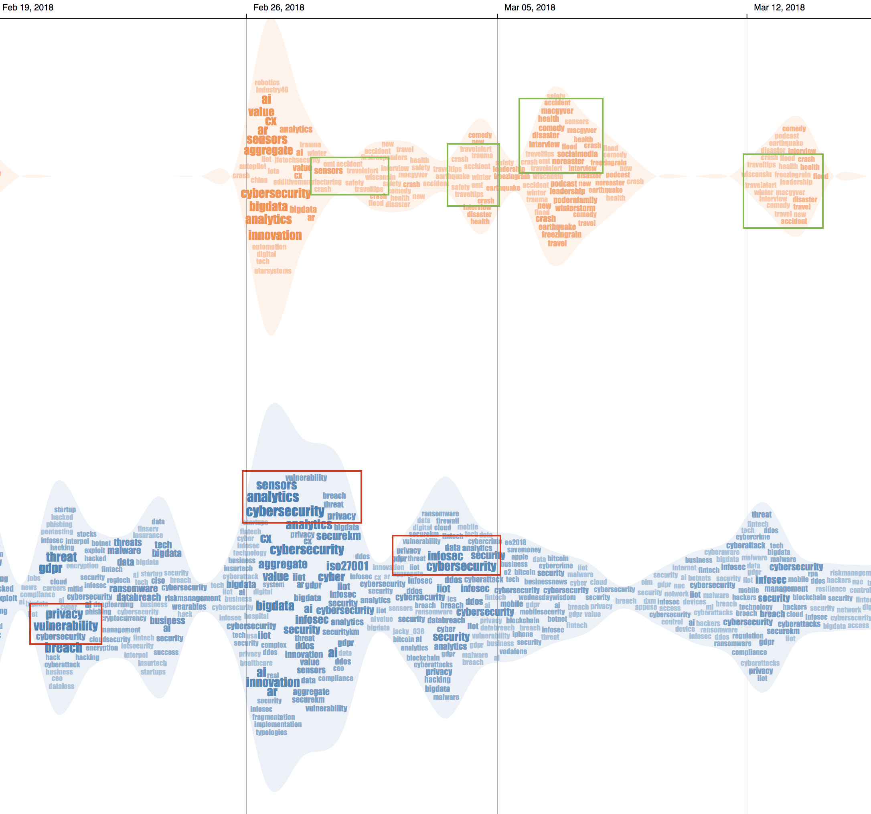
Case Study
Groups of words that often appear together: Showing relation in context between them
accident
travelalert
crash
Accuracy of travel alert: whether or not an accident or crash happens
cybersecurity
vulnerability
privacy
The vulnerability from cybersecurity may lead to privacy issues
risk and crash are the most popular words that span over a long period of time
12

Slide 13
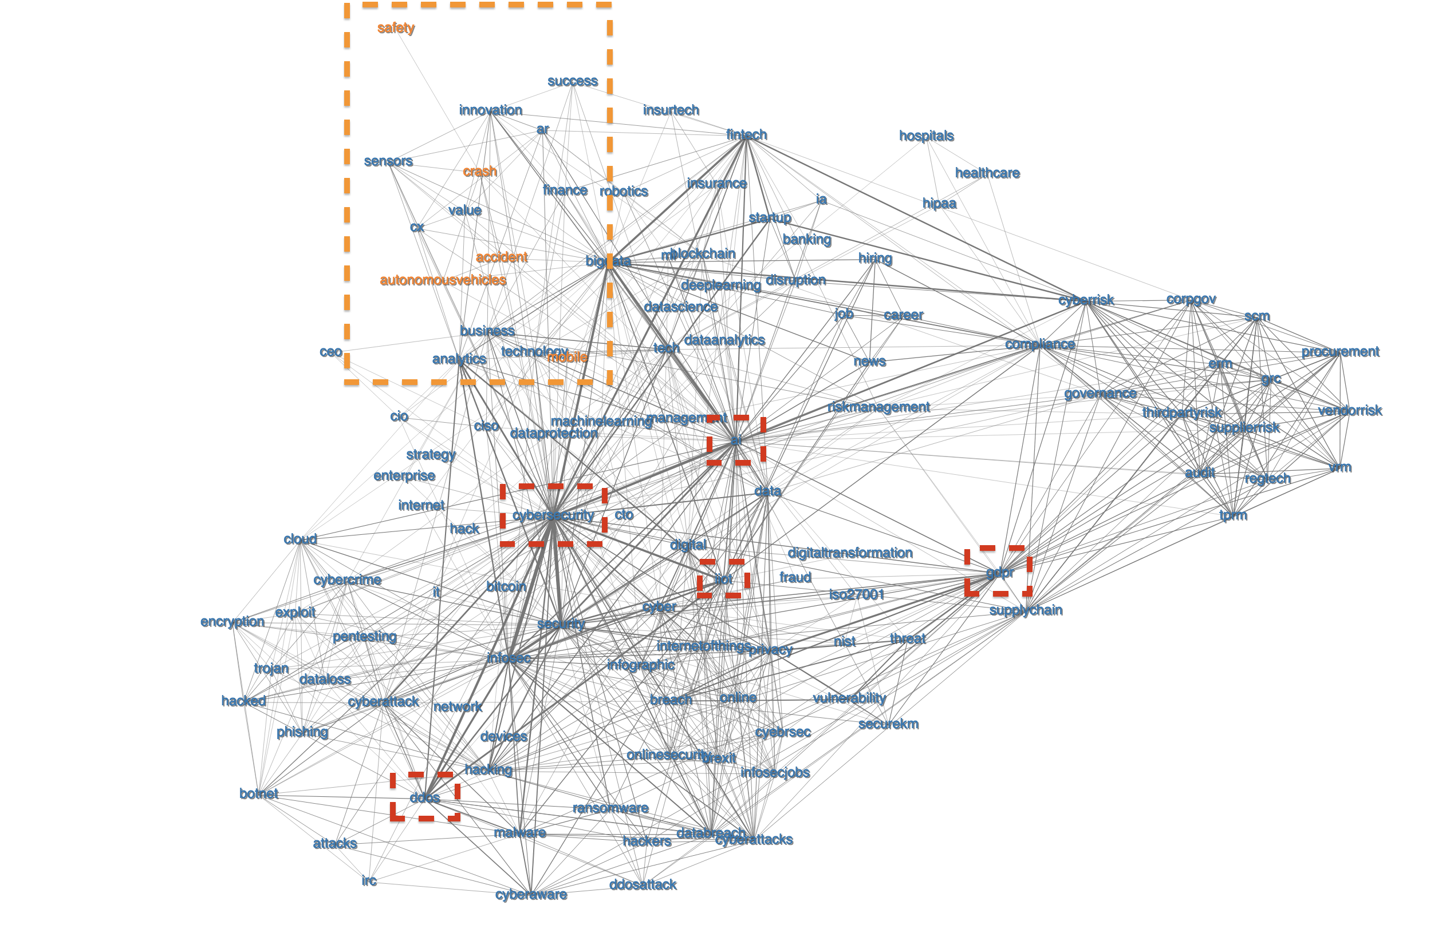
Case Study
The concern of accidents:
autonomousvehicles
crash
accident
safety
Terms with multiple relations
cybersecurity
ai
iiot (Industrial Internet of Things)
gdpr (General Data Protection Regulation)
ddos (Distributed Denial of Service).
14

Slide 14
Conclusion
We introduced IoTNegViz, interactive visual tool to help users summarize the IoT-related concerning issues over time.
IoTNegViz supports of a range of interactive features, such as highlighting and filtering, allowing users to quickly narrow down events of interest.
We demonstrate the usefulness of our tool through different use cases.
The purpose is to get users to raise awareness, be prepared, and therefore alleviate the existing problems.
15

Slide 15
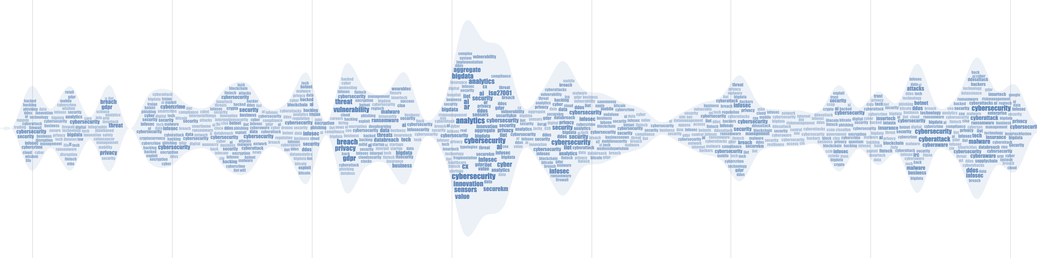

Questions?
Email: Tommy.Dang@ttu.edu
Demo: https://idatavisualizationlab.github.io/IoTNegViz/
interactive Data Visualization Lab
16

